Slide 1
Concepts of Database Management
Seventh Edition
Chapter 5
Database Design 1: Normalization

Slide 2
Objectives
Discuss functional dependence and primary keys
Define first normal form, second normal form, and fourth normal form
Describe the problems associated with tables (relations) that are not in first normal form, second normal form, or third normal form, along with the mechanism for converting to all three
Understand how normalization is used in the database design process

Slide 3
Introduction
Normalization process
  Identifying potential problems, called update anomalies, in the design of a relational database
  Methods for correcting these problems
Normal form: table has desirable properties
  First normal form (1NF)
  Second normal form (2NF)
  Third normal form (3NF)

Slide 4
Introduction (continued)
Normalization
  Table in first normal form better than table not in first normal form
  Table in second normal form better than table in first normal form, and so on
  Goal: new collection of tables that is free of update anomalies

Slide 5
Functional Dependence
A
B
A certain field say Column B
is functionally dependent
on another field say Column A
if Column B’s value depend
on the value of Column A. And also that Column A’s value is associated only with a exactly one value of Column B.
And so if Column B depends on Column A then it also means that Column A functionally determines Column B.

Slide 6
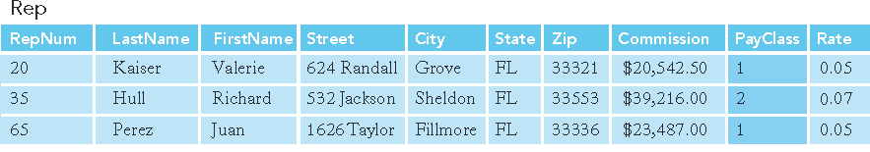
Functional Dependence (continued)
Let’s assume that in Premiere Products all Sales Rep in any given
Pay class earn the Commission Rate.
So, which means
a Sale’s Rep Pay Class
determines
his/her Commission Rate
And his/her Commission Rate
therefore depends
on his/her Pay Class
PayClass
Rate
FIGURE 5-2: Rep table with additional column, PayClass

Slide 7
Functional Dependence (continued)
Let’s make it a local example here. Suppose we have a Courses table below:
Course Code | Course Description
IS230 | Database Design
CA100 | Computer Literacy
BU101 | Intro to Business
Course Code
Course Description
That is, Course Code determines his/her Course Description
And Course Description depends on Course Code

Slide 8
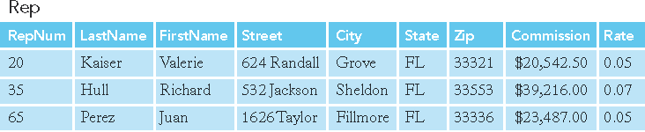
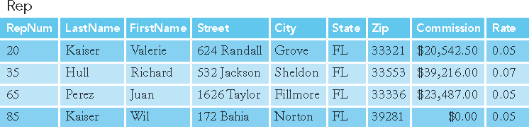
Let us examine Rep table on Premier Database
FIGURE 5-3: Rep table
FIGURE 5-4: Rep table with second rep named Kaiser added

Slide 9
Question?
Is Street functionally depend on Firstname or Lastname?

Slide 10
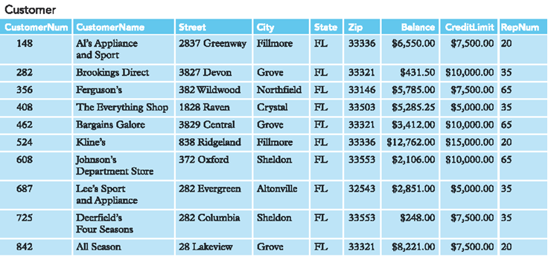
Question?
FIGURE 5-3: Rep table
Is CustomerName Functionally Dependent on RepNum?

Slide 11
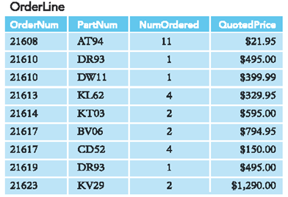
Question?
Is QuotedPrice Functionally Dependent on OrderNum?
Is QuotedPrice Functionally Dependent on PartNum?
So, on which columns does QuotedPrice is functionally dependent?

Slide 12
Non-Graded Exercise
Identify which field(s) is functionally dependent on which field(s)
And then which field(s) functionally determines which field(s).
StudID | StudeLast | StudFirst | HighSchoolNum | HighSchoolName | AdvisorNum | AdvisorName
1 | Cruz | John | 101 | CCA | 990 | Smith
2 | Moore | Anna | 102 | SDA | 991 | Song
3 | Friend | Fe | 101 | CCA | 991 | Song
4 | Zap | Mario | 103 | MNHS | 990 | Smith
5 | Bass | Gerard | 103 | MNHS | 992 | George

Slide 13
Three Normal Forms Mnemonics
In order to easily remember the three normal forms just remember the word RePeaT ignoring the vowels (which are in small letters) which are:
R – 1ST Normal Form - No Repeating groups or multi-valued fields
P – 2nd Normal Form - No Partial Dependence
T – 3rd Normal Form - No Transitional Dependence

Slide 14
First Normal Form
There should be no repeating group or multi-valued columns in order for a Table to be in first normal form.
  Repeating group: multiple entries for a single record
  Unnormalized relation: contains a repeating group

Slide 15
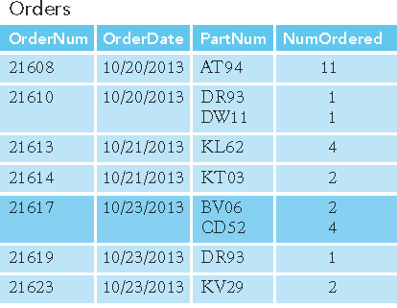
First Normal Form (continued)
Orders (OrderNum, OrderDate, (PartNum, NumOrdered) )
Multi-valued Columns
Multi-valued Columns
FIGURE 5-5: Sample unnormalized table

Slide 16
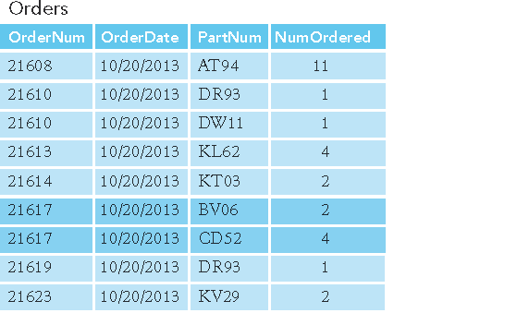
First Normal Form (continued)
Orders (OrderNum, OrderDate, PartNum, NumOrdered)
Converted to
First Normal Form
No more Multi-valued
fields
FIGURE 5-6: Result of normalization (conversion to first normal form)

Slide 17
First Normal Form (continued)
Below is a Table students and the course they are taking here at COM:
CoursesTaken
StudentID | Lastname | Firstname | Program | CourseCode
222333 | Khan | Bert | CIS | IS230
222333 | Khan | Bert | CIS | IS220
222333 | Khan | Bert | CIS | MS100
Repeating Groups violates 1NF

Slide 18
First Normal Form (continued)
To convert to First Normal Form (1NF) is to remove the multi-value column
CoursesTaken
StudentID | Lastname | Firstname | Program | CourseCode
222333 | Khan | Bert | CIS | IS230
222333 | Khan | Bert | CIS | IS220
222333 | Khan | Bert | CIS | MS100
X
Remove Repeating Groups

Slide 19
First Normal Form (continued)
And create a new Table let’s say named Students and relate the two.
CoursesTaken
CourseID | StudentID | CourseCode
101 | 222333 | IS230
102 | 222333 | IS220
103 | 222333 | ED210
Students
StudentID | Lastname | Firstname | Program
222333 | Khan | Bert | CIS

Slide 20
Non-Graded Exercise
Convert to 1NF the Table below which records the employee and his/her computer skills.
Employees
EmployeeID | Lastname | Firstname | Gender | Computer Skills
1 | James | George | M | Encoding, MS Office, Photoshop
2 | Miles | May | F | Encoding, Programming, Database Design
3 | Gates | Alan | M | Programming, MS Office

Slide 21
Non-Graded Exercise
Convert to 1NF the Table below which records the students and the school club that he/she joins in.
Students
StudentID | Lastname | Firstname | SchoolClub
88855 | Combe | Aber | Math Club
88855 | Combe | Aber | Computer Club
77744 | Vibrant | Vive | Social Club

Slide 22
Second Normal Form (continued)
Table (relation) in second normal form (2NF)
  Table is in first normal form
  No nonkey column (not a primary key) column should be partially dependent of a composite primary key.
    Partial dependencies: only on a portion of the primary key

Slide 23
Second Normal Form (continued)
Below is a Table of the courses taken by students
CourseTaken
StudentID | Lastname | Firstname | Program | CoursesCode | CourseDescription
457411 | Red | Ray | CIS | IS230 | Database Design
457411 | Red | Ray | CIS | CA105 | Data Analysis
444771 | Call | Sabrina | Business | BU101 | Intro to Business
Lastname, Firstname, Program are
dependent on StudentID
but not on CourseCode and
StudentID
CourseDescription is
dependent on CourseCode
but not on CourseCode and
StudentID

Slide 24
Second Normal Form (continued)
To convert to 2NF remove partially dependent fields and make it as another table.
CourseTaken
StudentID | Lastname | Firstname | Program | CoursesCode | CourseDescription
457411 | Red | Ray | CIS | IS230 | Database Design
457411 | Red | Ray | CIS | CA105 | Data Analysis
444771 | Call | Sabrina | Business | BU101 | Intro to Business
X
X
Remove Partially
Dependent Fields
Remove Partially
Dependent Field

Slide 25
Second Normal Form (continued)
Converting into a new Table those who are partially dependent
Students
Courses
StudentID | Lastname | Firstname | Program
457411 | Red | Ray | CIS
444771 | Call | Sabrina | Business
CoursesCode | CourseDescription
IS230 | Database Design
CA105 | Data Analysis
BU101 | Intro to Business
CoursesTaken
StudentID | CoursesCode
457411 | IS230
457411 | CA105
444771 | BU101

Slide 26
Non-Graded Exercise
Convert to 2NF the Table below which Customer’s purchase from which store location.
CustomersPurchase
CustomerID | StoreID | StoreLocation
1 | 1 | Manila
2 | 2 | Pohnpei
2 | 1 | Manila
3 | 4 | Hilo
4 | 3 | LA
5 | 4 | Hilo

Slide 27
Third Normal Form (continued)
Table (relation) in third normal form (3NF)
  It is in second normal form
  There should no non-primary key that is transitional dependent to a primary key.

Slide 28
Third Normal Form
Customer (CustomerNum, CustomerName, Balance, CreditLimit, RepNum, LastName, FirstName)
Functional dependencies:
  CustomerNum → CustomerName, Balance, CreditLimit, RepNum, LastName, FirstName
  RepNum → LastName, FirstName

Slide 29
Third Normal Form (continued)
Correction procedure
  Remove each column that is transitionally dependent.
  Create a new table, transferring the removed columns to the newly created table.
  Make a primary key of the new table
  And use the primary key as the foreign key from the table where the columns were removed earlier.

Slide 30
Third Normal Form (continued)
Below is a Table students the program he/she belongs here at COM
Students
StudentID | Lastname | Firstname | ProgramCode | ProgramName
12345 | Green | Arnel | CIS | Computer Information Systems
23456 | Azure | Zenaida | GenEd | General Education
34567 | Brown | Country | LA | Liberal Arts
ProgramName is
Dependent on ProgramCode
not StudentID which is
the PK

Slide 31
Third Normal Form (continued)
To convert to Third Normal Form (3NF) is to remove the Transitory Dependent column:
Students
StudentID | Lastname | Firstname | ProgramCode | ProgramName
12345 | Green | Arnel | CIS | Computer Information Systems
23456 | Azure | Zenaida | GenEd | General Education
34567 | Brown | Country | LA | Liberal Arts
X
Remove Transitory
Dependent Column

Slide 32
Third Normal Form (continued)
And create a new Table out of it let’s say we name it Programs and relate the two.
Students
StudentID | Lastname | Firstname | ProgramCode
12345 | Green | Arnel | CIS
23456 | Azure | Zenaida | GenEd
34567 | Brown | Country | LA
Programs
ProgramCode | ProgramName
CIS | Computer Information Systems
GenEd | General Education
LA | Liberal Arts

Slide 33
Third Normal Form (continued)
Or we could create a new Primary Key for Programs and do like this:
Students
StudentID | Lastname | Firstname | ProgramID
12345 | Green | Arnel | 1
23456 | Azure | Zenaida | 2
34567 | Brown | Country | 3
Programs
ProgramID | ProgramCode | ProgramName
1 | CIS | Computer Information Systems
2 | GenEd | General Education
3 | LA | Liberal Arts

Slide 34
Non-Graded Exercise
Convert to 3NF the Table (i.e. Employees) below which records the Employee’s info including his/her department.
Employees
EmployeeID | Lastname | Firstname | DepartmentCode | DepartmentName
1001 | Mills | Karen | SAL01 | Sales North
1002 | Courtney | Francis | SAL02 | Sales South
1003 | Smith | Phillip | ENG01 | Engineering Design
1005 | Xavier | Duran | ENG02 | Engineering Construction
1004 | Morrison | John | SAL02 | Sales South

Slide 35

More Practice Exercises

Slide 36
Non-Graded Exercise
Let’s say we want to store into a table, Students who are borrowing books from the Library
StudentID | Lastname | Firstname | BooksBorrowed
1001 | Mills | Karen | College Algebra, Cooking in Micronesia, Data Analysis
1002 | Courtney | Francis | Statistics, Chronicles of Narnia
1003 | Smith | Phillip | Hermeneutics, Bible Mysteries solved
What Normal Form did it violate?
How should we normalized the above table?

Slide 37
Non-Graded Exercise
Let’s say we want to record the books that Students borrow. And let’s assume
that there is already a Table named Students that contains basic information for
Students like first name, last name, student ID etc.
StudentID | DateBorrowed | ReturnDate | BookNumber | BookTitle
22222 | 09/16/13 | 09/23/13 | BKN13981 | War and Peace
23232 | 09/18/13 | 09/20/13 | XYZ39825 | Algorithm
24242 | 09/12/13 | 09/19/13 | ABC36987 | Peace with GOD
22222 | 09/16/13 | 09/23/13 | JIP879874 | Incredible Journey
What Normal Form did it violate?
How should we normalized the above table?

Slide 38
Non-Graded Exercise
Let’s say we want to record the Courses that Faculties taught this semester on a
Table like one below and CourseAssignID is the Primary Key.
Course AssignID | FacultyNum | Lastname | Firstname | CourseCode | Section
1 | 2010-12 | Ullman | Kathy | IS230 | 1
2 | 1998-25 | Gent | Kris | EN110 | 5
3 | 2013-01 | Chiu | Ching | CA100 | 1
4 | 2008-78 | Moore | Alexis | CA100 | 2
What Normal Form did it violate?
How should we normalized the above table?

Slide 39
Graded Case Study – Alexamara
Problem 1 : Normalize the table below which is about owners and the boat(s) they
owned
OwnerNum | LastName | FirstName | BoatName | Weight | Marina
AD57 | Adney | Bruce and Jean | AdBruce X | 1,000 lbs | East
 |  |  | Zinger | 1,500 lbs | East
AN75 | Anderson | Bill | Yellow Beast | 2,000 lbs | West
BL72 | Blake | Mary | Kumodo | 1,200 lbs | East
 |  |  | Kryptonite | 1,000 lbs | West
EL25 | Elend | Sandy and Bill | Shark Fin | 1,300 lbs | East
 |  |  | Two Cute | 900 lbs | East
 |  |  | Ride North | 1,400 lbs | West

Slide 40
Graded Case Study - Alexamara
Problem 2 : Normalize the table below regarding the Boats in Marina Slip and its
corresponding owners.
SlipID | MarinaNum | SlipNum | Length | RentalFee | BoatName | BoatType | OwnerNum | OwnerLastName | OwnerFirstName
1 | 1 | A1 | 40 | $3,800.00 | Anderson II | Sprite 4000 | AN75 | Anderson | Bill
2 | 1 | A2 | 40 | $3,800.00 | Our Toy | Ray 4025 | EL25 | Elend | Sand and Bill
3 | 1 | A3 | 40 | $3,600.00 | Escape | Sprite 4000 | KE22 | Kelly | Allysa
4 | 1 | B1 | 30 | $2,400.00 | Gypsy | Dolphin 28 | JU92 | Juarez | Maria
5 | 1 | B2 | 30 | $2,600.00 | Anderson III | Sprite 3000 | AN75 | Anderson | Bill
6 | 2 | 1 | 25 | $1,800.00 | Bravo | Dolphin 25 | AD57 | Adney | Bruce and Jean
7 | 2 | 2 | 25 | $1,800.00 | Chinook | Dolphin 22 | FE82 | Feenstra | Daniel
8 | 2 | 3 | 25 | $2,000.00 | Listy | Dolphin 25 | SM72 | Smeltz | Beck and Dave
9 | 2 | 4 | 30 | $2,500.00 | Mermaid | Dolphin 28 | BL72 | Blake | Mary
10 | 2 | 5 | 40 | $4,200.00 | Axxon II | Dolphin 40 | NO27 | Norton | Peter
11 | 2 | 6 | 40 | $4,200.00 | Karvel | Ray 4025 | TR72 | Trent | Ashton

Slide 41
Graded Case Study – Henry Books
Problem 1 : Normalize the table below regarding Publishers and the Books they
published.
PublisherCode | PublisherName | City | BookTitle | YearPublished
AH | Arkham House | Sauk City WI | Dream House | 1999
 |  |  | Partial Recall | 2011
AP | Arcade Publishing | New York | Games Played | 1982
BA | Basic Books | Boulder CO | Dance Fundamentals | 1980
 |  |  | Booking the Flight | 1993
BP | Berkley Publishing | Boston | Bastketball glory | 2001
VB | Vintage Books | New York | Archive Reload | 1998
 |  |  | Rusty Road | 2002
WN | W.W. Norton | New York | War and Breeze | 2006
WP | Westview Press | Boulder CO | General Goodwill | 1978

Slide 42
Graded Case Study – Henry Books
Problem 2 : Normalize the table below regarding Books and their corresponding
author.
BookCode | Title | AuthorCode | AuthorFirstname | AuthorLastname
0180 | A Deepness in the Sky | 1001 | George | Graham
0189 | Magic Terror | 1002 | Earl | Johnson
0200 | The Stranger | 1001 | George | Graham
0378 | Venice | 1003 | Vitali | Pablo
079X | Second Wind | 1004 | Strong | Mary
0808 | The Edge | 1002 | Earl | Johnson

Slide 43
Summary
Column (attribute) B is functionally dependent on another column A (or collection of columns) when each value for A in the database is associated with exactly one value of B
Column(s) A is the primary key if all other columns are functionally dependent on A and no sub-collection of columns in A also have this property

Slide 44
Summary (continued)
Table (relation) in first normal form (1NF) does not contain repeating groups
Nonkey column (or nonkey attribute) is not a part of the primary key
Table (relation) is in the second normal form (2NF) when it is in 1NF and no nonkey column is dependent on only a portion of the primary key
Determinant is a column that functionally determines another column

Slide 45
Summary (continued)
Table (relation) is in third normal form (3NF) when it is in 2NF and its only determinants are candidate keys
Collection of tables (relations) that is not in third normal form has inherent problems called update anomalies

